Slide 1
The Skeletal System

Slide 2
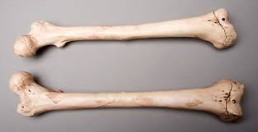
The Skeletal System-
Parts of the skeletal system
Bones
Joints
Cartilages
Ligaments (bone to bone)
Tendons (bone to muscle)

Slide 3
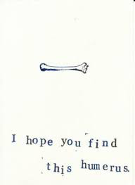
Functions of Skeletal System
What functions can you think of????

Slide 4

Functions of Skeletal System
Support of the body and give it shape
Protection of soft organs
Movement

Slide 5
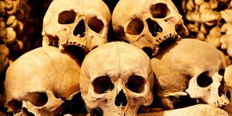
Functions of Skeletal System
Storage of minerals and fats i.e. calcium, sodium
Blood cell formation

Slide 6
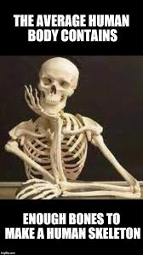
Bones of the Human Body
The skeleton has 206 bones
Two basic types of bone tissue
Compact bone
Spongy bone or cancellous bone

Slide 7
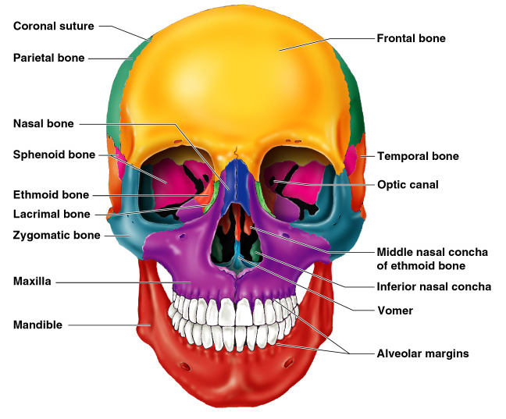
Notes:
the function : support and protect the brain page 11

Slide 8
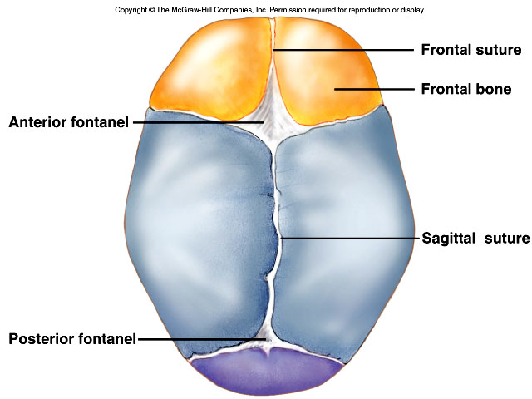

Slide 9
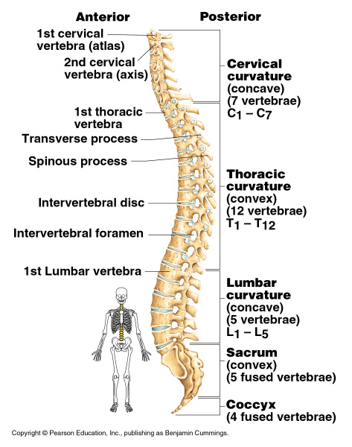
Notes:
Function – has an s- curve to allowing us to stand upright and walk

Slide 10
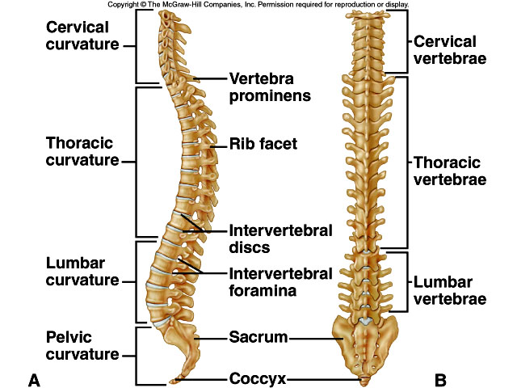

Slide 11
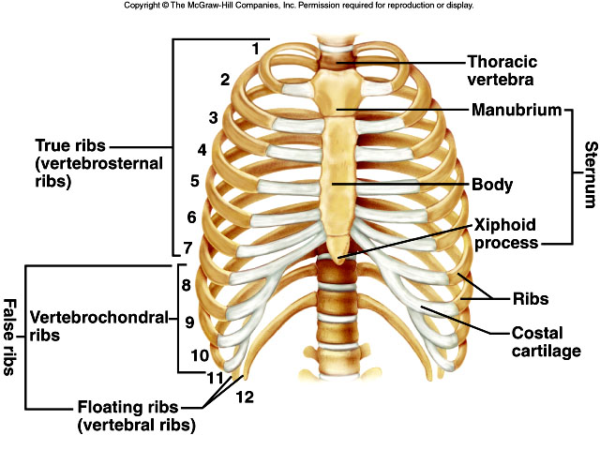
Notes:
Fucntion: protect organs and allow us to breath due to cartilage

Slide 12
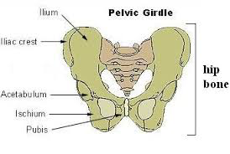
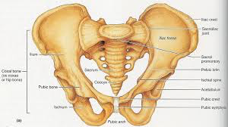
Notes:
Fucntion: supports organs and leg movement. In females is allows them to a feotus and give birth.

Slide 13
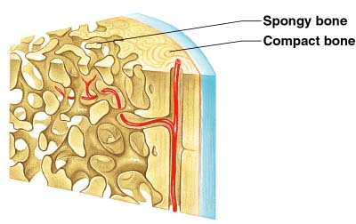
Bones of the Human Body

Slide 14
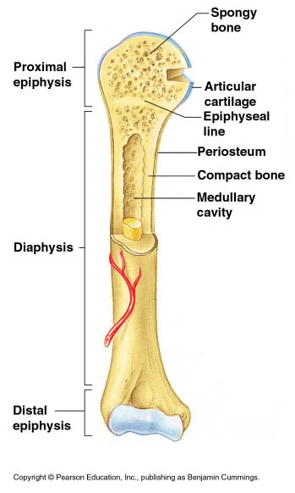
Structure of a Long Bone
Diaphysis
Shaft
Composed of compact bone
Figure 5.2a

Slide 15
Structure of a Long Bone
Diaphysis
Contains yellow bone marrow and is a fat storage site
Figure 5.2a

Slide 16
Figure 5.2a

Slide 17
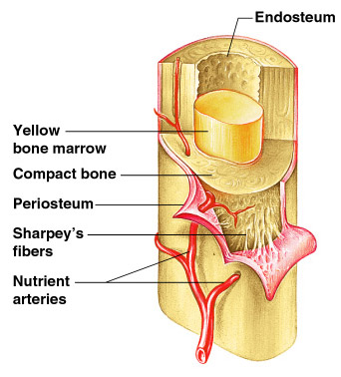
Structure of a Long Bone
Periosteum
Outside covering of the diaphysis
Connective tissue membrane
Figure 5.2c

Slide 18
Structure of a Long Bone
Epiphysis
Ends of the bone
Mostly of spongy bone
Covered by a thin layer of cartilage
Figure 5.2a

Slide 19
Structure of a Long Bone
Epiphysis
Spongy or cancellous bone may have red bone marrow (where red blood cells are produced.)
Figure 5.2a

Slide 20
Structure of a Long Bone
Epiphyseal line
Called a plate in children and adolescents.
Hyaline cartilage

Slide 22
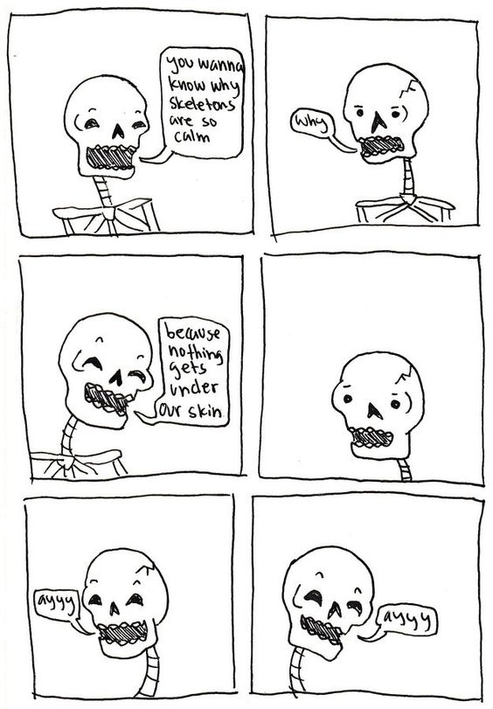
Worksheet

Slide 23
Osteocyte, Osteoblast and Osteoclast
Osteocyte: a mature bone cell
Osteoblast: immature bone cell. Involved in “bone building” and repair
Osteoclast: a type of bone cell. Involved in “bone eating” (absorbs bone tissue)

Slide 24
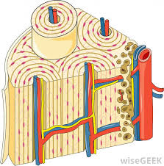
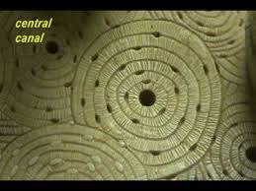
Microscopic Anatomy of Compact Bone
Osteon:
Circular formations that make up bone

Slide 25
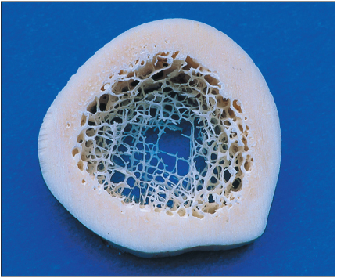
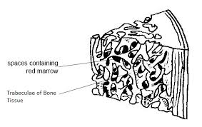
Microscopic Anatomy of Spongy Bone
Trabeculae.
An arrangement of irregular thin plates.

Slide 26
Classification of Bones
Classify bones by grouping them based on shape and division
List the steps of bone repair and growth

Slide 27
Classification of Bones: SHAPE
Figure 5.1

Slide 28
Classification of Bones: SHAPE
Figure 5.1

Slide 29
Classification of Bones: DIVISIONS
Axial skeleton
Appendicular skeleton

Slide 30
Bone Repair

Slide 31
Bone Repair

Slide 32
Bone Repair

Slide 33
Bone Repair

Slide 34
Bone Repair

Slide 35
Bone Repair

Slide 36
Bone Repair
1. Blood clotting
and swelling.

Slide 37
Bone Repair
1. Blood clotting
and swelling.
2. Cartilage forms a mesh work/frame work.

Slide 38
Bone Repair
1. Blood clotting
and swelling.
2. Cartilage forms a mesh work/frame work.
3. This is then replaced with spongy bone and eventually compact bone.

Slide 39
Bone Repair
1. Blood clotting
and swelling.
2. Cartilage forms a mesh work/frame work.
3. This is then replaced with spongy bone and eventually compact bone.
4. Slowly the bone is reshaped. And blood vessels heal.

Slide 40
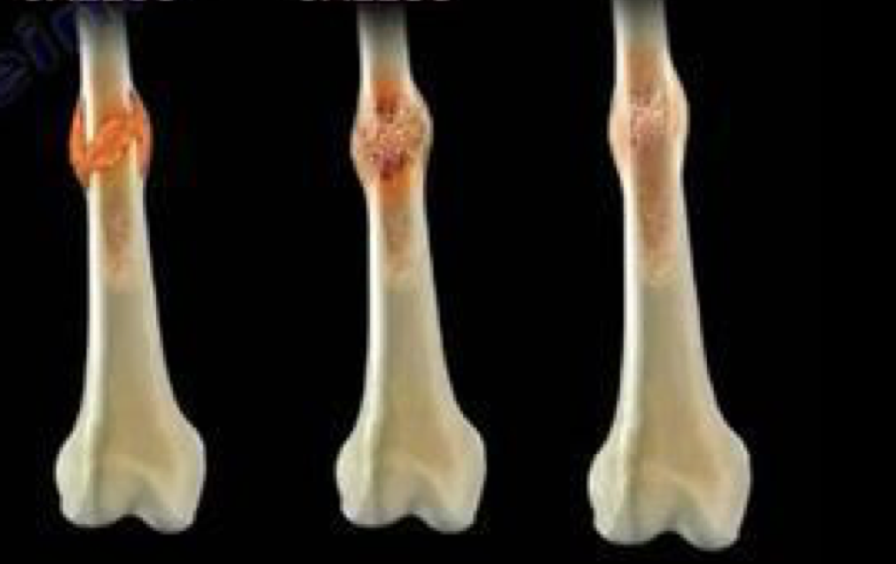

Slide 41
Bone Growth
Embryo: all bone cartilage
Foetus: ossification occurs
Ossification occurs until end of adolescence
Ossification:
The process of creating bone, that is transforming cartilage into bone.

Slide 42
Bone vs Cartilage

Slide 43
Bone vs Cartilage
 | bone | cartilage
types | Compact or spongy. Long, short, flat, irregular or sesamoid | Hyaline cartilage, fibrocartilage, elastic cartilage, articular cartilage
function | Protect, movement, provide a framework and shape, store minerals, and produce blood cells. | Reducing friction at joints, supporting the respiratory tract, acting as shock absorbers and maintaining the shape and flexibility of fleshy appendages.

Slide 44
Bone vs Cartilage
 | bone | cartilage
structure | Osteoblast, osteocytes and osteoclasts | Chondroblasts (immature cartilage cells), chondrocytes (mature cartilage cells) and a dense matrix of collagen.
location | Axial and appendicular | Between joints and along respiratory tract

